Slide 1
Data Structures
with
C++
Lecture#12 Application of Stack– infix to postfix

Slide 2
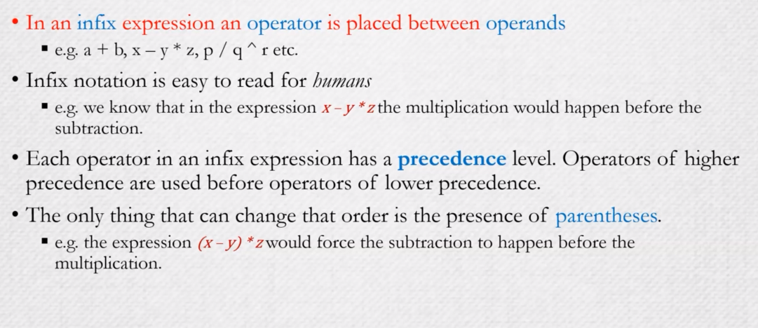
Infix Expressions

Slide 3
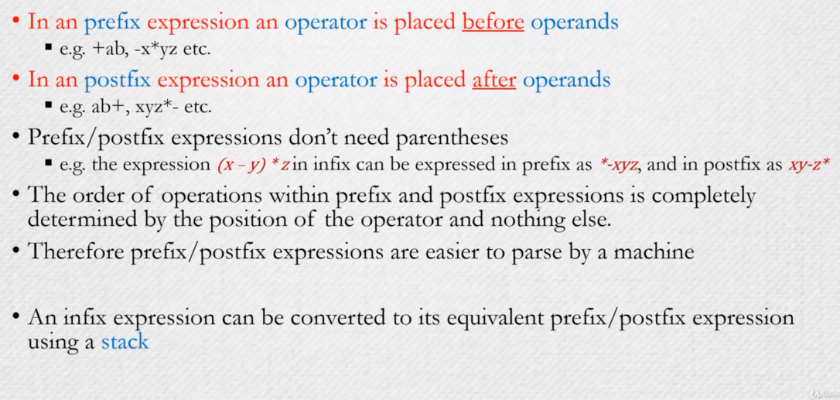
Infix\postfix Expressions

Slide 4
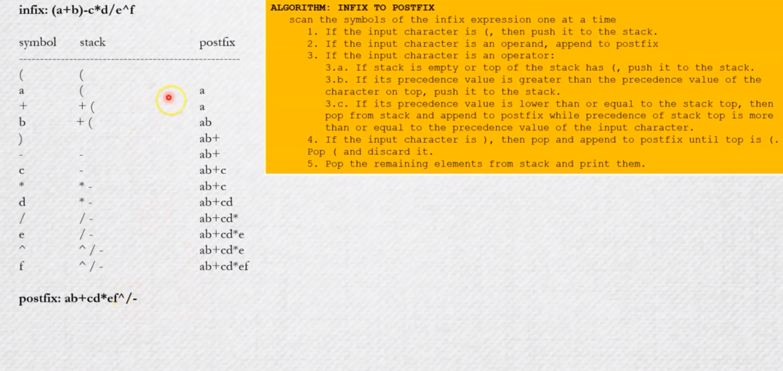
Infix to postfix conversion

Slide 5
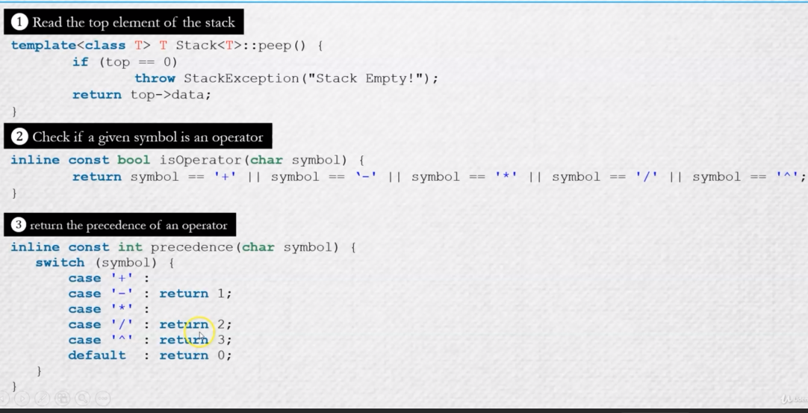
Adding methods
n
data
next
0
top

Slide 6
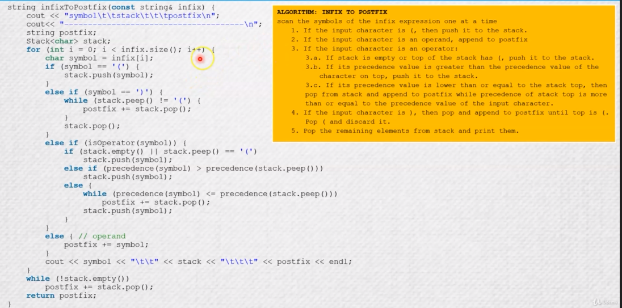
implementation

Slide 7
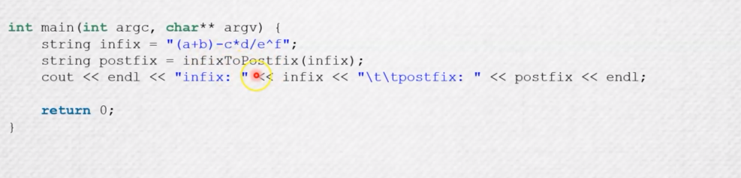
Testing code

Slide 8


